Slide 2
Quick Introduction
Gabriel Abiera
BS Computer Science major in Computer Systems Engineering, DLSU Manila, Oct 2013
MS Computer Science, DLSU Manila
Systems Engineer, Cascadeo Corporation
gabriel@cascadeo.com

Slide 3
Microcontroller Meets the World
Analog Input and Output

Slide 4
Previously…
Learned how to interface your microcontroller via digital signals
Signals consist of two values, either a HIGH or LOW
HIGH (5V)
LOW (0V)

Slide 5
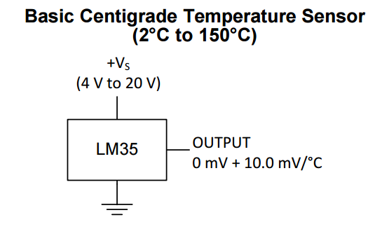
Consider the following
A sensor X that produces a signal varying voltage level between 0-5V equivalent to something that it measures.
EG: A temperature sensor that produces a reading of 10mV per C
How do we measure this?
Notice that we cannot use digital inputs as they are limited to reading two values, a HIGH value and LOW value

Slide 6
Go Analog
In this case, the concept of “analog” is the ability of the device to recognize other voltage levels
In theory, they can represent a “continuous” range of values

Slide 7
Real-world Limitations
Gizduino is a digital system
Perform a conversion of the Analog signal into a Digital Representation
There is a limit to the number of voltage levels that can be represented by the analog signal
EG: Gizduino IOT board has a 10-bit ADC (analog-digital converter) resolution

Slide 8
Digital
Analog
5V
HIGH
1023
1024 Levels
5/1024 V per level
2¹⁰ = 1024
LOW
0
0V

Slide 9
Analog Input
analogRead(channel)
Perform ADC from a specific channel (A0-A5)
Returns an integer with value from 0-1023
Syntax:
var = analogRead(channel)
channel = number label of analog pin input to be read
var = variable assigned to hold the read value

Slide 10
eg: reading temperature from a LM35
const int = A0;
float getTemp() {
int sensorValue = analogRead(tempinput);
float millivolts = (sensorValue/1024.0) * 5000;
float celsius = millivolts/10;
return celsius;
}

Slide 11
Things to consider for analog input
Input Signal is limited to values between 0-5V maximum.
Sampling rate of your routine compared to the signal
Number of samples / second
General rule: sampling rate should be at least twice as fast as the signal.
At maximum, Arduino’s documentation states a theoretical maximum of around 10,000 samples/sec (10KHz) (realistically: around 8k samples/sec)
With some alterations, you can go as high as 77KHz in theory (~56KHz realistically)
Greatly depends on the computational load your MCU is doing
Read more: https://sites.google.com/site/measuringstuff/the-arduino#TOC-Sample-Rates

Slide 12
Speaking of sensors
Devices that respond to an external stimulus and give off signals with respect to that event
Either go or no-go sensors or analog sensors
Go or no-go: normally produces a binary output like switches
Analog sensors: produces varying-level outputs
Also known as transducers
where energy (the stimulus) is converted another form (for example, varying voltage levels)

Slide 13
Some Important Notes on Sensors
Know your sensor:
check the data sheets for proper interfacing
Calibration

Slide 14
<potential sensors slides go here, will put later if there is time>

Slide 15
What about output?
We talked about analog input, what about output?
If there is an ADC, there is also such a thing as a DAC (digital-analog output)
Has a resolution that represents the number of voltage levels the DAC can output
Has a voltage range that determine the min/max of the output signal
Also has a sampling rate that determines the maximum frequency of the signal that can be generated
HOWEVER: our Gizduino does not come with a built-in DAC

Slide 16
PWM- Pulse Width Modulation
Our gizduino IOT board does have PWM
PWM varies the duty cycle of the output digital signal
Duty Cycle refers to the width of the HIGH phase compared to the period of the signal
HIGH
HIGH
100% DC
LOW
0% DC
LOW
HIGH
25% DC
HIGH
LOW
50% DC
HIGH
LOW
75% DC
LOW

Slide 17
PWM (cont)
Pin is turned on and off in a fast manner—achieving an “averaged” effect on the output side
For example, a 100% DC signal can be considered to produce a 100% output on the light intensity of a LED, a 50% DC signal can be considered to produce a 50% output on the light intensity of the same LED
Frequency of switching is around 488Hz for pins 4, 5, 9 and 10 (double for 6 and 7)
Can be controlled by additional settings (beware of dragons as some changes may change the behavior of timer-based functions)
Read more on: https://www.arduino.cc/en/Tutorial/SecretsOfArduinoPWM

Slide 18
“Analog Output”
analogWrite(pin, dc)
outputs a square wave with duty cycle determined by dc / 255.
Pins available: 4, 5, 6, 7, 9, 10
Syntax:
analogRead(pin, dc)
pin = pin where output signal is desired
dc = value from 0-255 that determines the duty cycle desired where x = dc/255, x being from 0-100%

Slide 19
Sample uses of PWM in controlling analog actuators

Slide 20
Internet of Things (IOT)
What is it?
Network of physical devices all interconnected that collect and exchange data
Devices range from sensors, embedded systems, to your toaster and coffee maker
Global Standards Initiative on Internet of Things (IoT-GSI) defined IoT as “the infrastructure of information society”
Devices can be sensed and controlled remotely
Allows the physical world to connect with the digital realm

Slide 21
IoT Applications
Smart Homes
Homes that can adjust to your mood (variable lighting, music plays when you enter your home, automatic temperature adjustment)
Intelligent Transportation
Smart Cities
Healthcare devices
Interconnection between smart phones, smart watches, and smart devices can be considered as part of IoT.

Slide 22
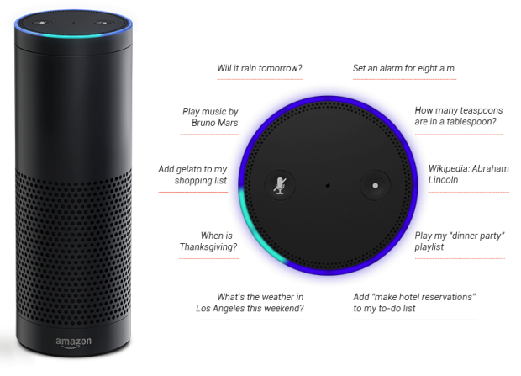

Amazon Echo

Slide 23
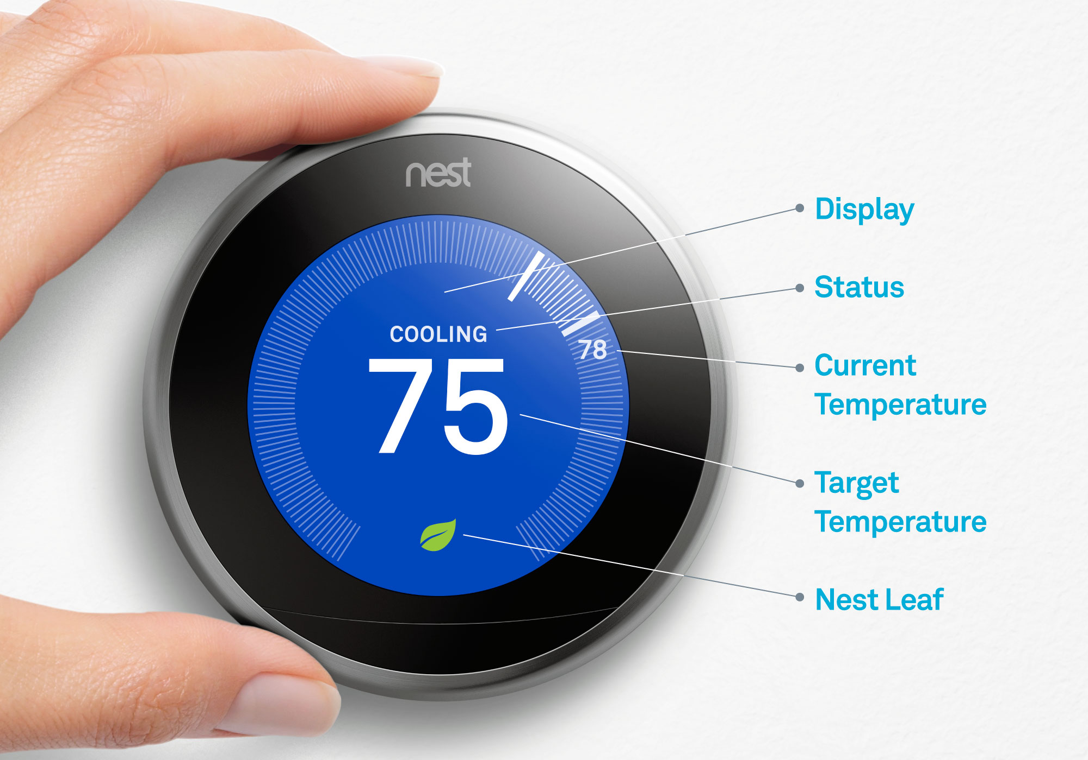
Nest Learning Thermostat
Automated Thermostat
Helps save energy

Slide 24
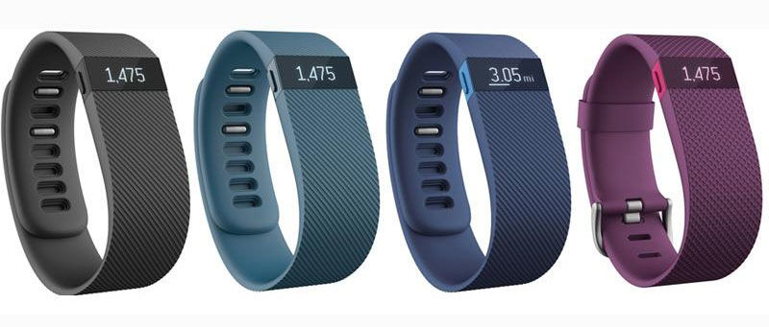
FitBit
Remote heartrate monitoring
Aid in achieving fitness goals

Slide 25
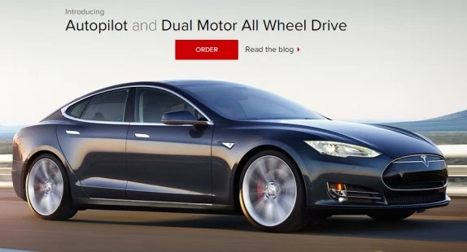
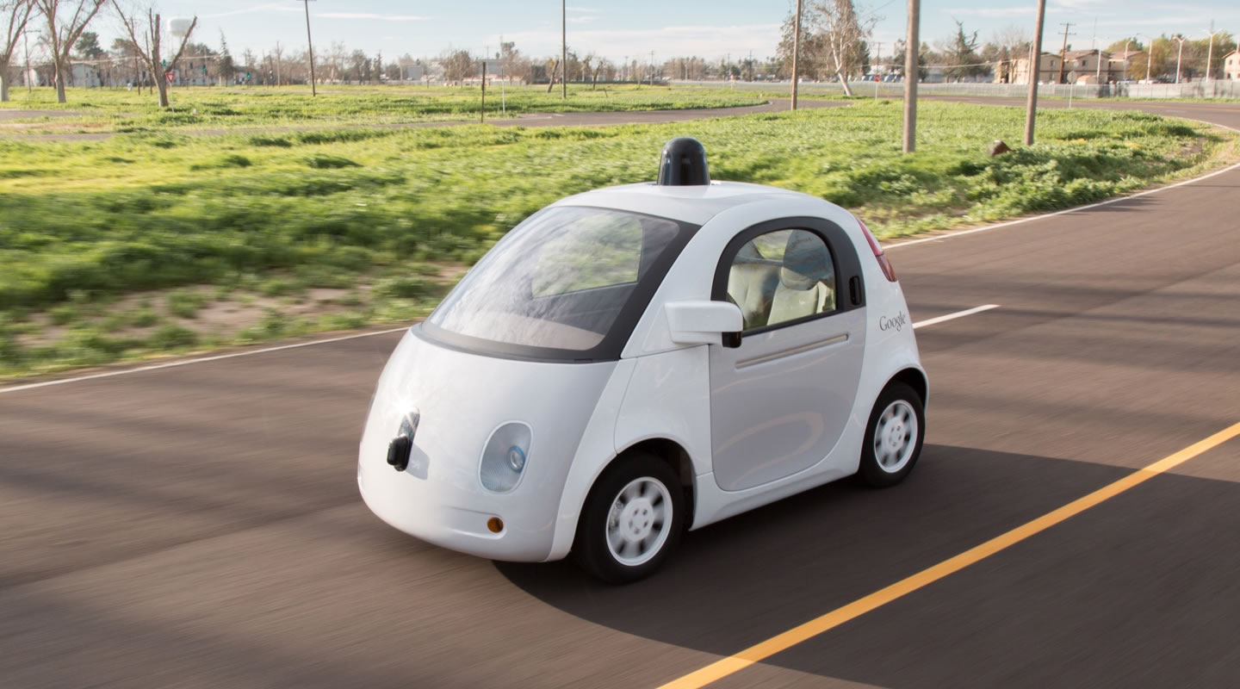
Self-Driving Cars

Slide 26
IoT Continued
All these components have one thing in common: Automation
Data can be collected and devices can be controlled remotely via smart phones or any remote device
Devices can even adapt to varying conditions due to the excessive amount of data available
Goal is to make life more convenient and technology ubiquitous

Slide 27
Cloud Technologies
Knowledge on several cloud technologies is also an advantage\
Perform your computations on the cloud!

Slide 28
Big Data and Analytics
With so much data, we need tools to analyze data efficiently
Perform computations on massive amounts of input in seconds
Real-time analytics is beneficial when you want to extract information from your devices in real-time
Notable tools are Hadoop and Apache Spark

Slide 29
Challenges
Ubiquity
Accessibility
Security
Scalability

Slide 30
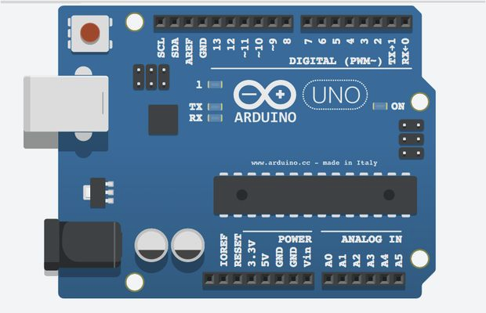
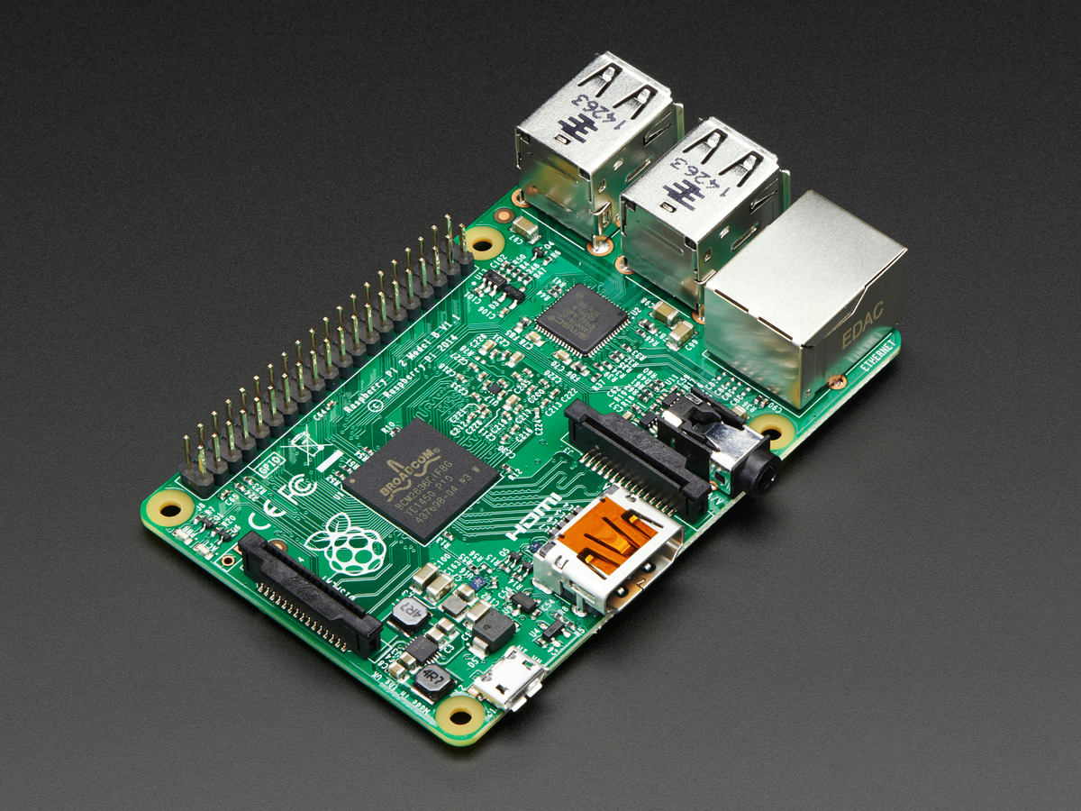
Microcontrollers and other devices

Slide 31
Networking
Practice of linking multiple computing devices together in order to share resources or data
Resources can be physical devices: phones, printers, laptops
But can also be something digital such as e-mails, instant messages, Facebook notifications etc.
Devices can be linked via cables, radio waves, wi-fi, infrared beams, etc. to form a network

Slide 32
Networking Basics
Network Devices
Networking Layers
IP Addressing
Subnetting
Ports

Slide 33
Network Devices
Switches
Connect as many devices on the same network.
Devices are generally within the same vicinity
Acts as a controller to share information with one another
Routers
Connect different networks to each other
Allows for data exchange between networks
Acts as a dispatcher: packages digital information and chooses the best route possible

Slide 34
IP Addressing
Numerical address assigned to a device in a network
Two functions
Network interface identification
Device addressing
Essentially indicates where is the device
IPV4 and IPV6

Slide 35
Subnets
The logical division of an IP address.
Dividing a network (composed of IP Addresses) into two or more networks is called subnetting.

Slide 36
IPV4 Addressing
Consists of 32-bits
Has 4,294,967,296 possible addresses
 | Binary form | Dot-decimal notation
IP address | 11000000.10101000.00000101.10000010 | 192.168.5.130
Subnet mask | 11111111.11111111.11111111.00000000 | 255.255.255.0
Network prefix | 11000000.10101000.00000101.00000000 | 192.168.5.0
Host part | 00000000.00000000.00000000.10000010 | 0.0.0.130

Slide 37
Ports
An endpoint for your devices
Always associated with an IP address of a host and protocol type
16-bit numbers that are associated with every IP address
Access devices by specifying its available ports.

Slide 38
Ethernet

Slide 39
Ethernet
Gizduino IOT provides an integrated Ethernet port along with libraries designed to help facilitate TCP/IP Communications
Enables the embedded platform to talk via a network to other services

Slide 40
How to start?
In void setup()
#if defined(WIZ550io_WITH_MACADDRESS)
if (Ethernet.begin() == 0) {
#else
if (Ethernet.begin(mac) == 0) {
#endif
Serial.println("Failed to configure Ethernet using DHCP");
#if defined(WIZ550io_WITH_MACADDRESS)
Ethernet.begin(ip);
#else
Ethernet.begin(mac, ip, mydns, gwip, snip);
#endif
}

Slide 41
How to start?
In void setup()
#if defined(WIZ550io_WITH_MACADDRESS)
if (Ethernet.begin() == 0) {
#else
if (Ethernet.begin(mac) == 0) {
#endif
Serial.println("Failed to configure Ethernet using DHCP");
#if defined(WIZ550io_WITH_MACADDRESS)
Ethernet.begin(ip);
#else
Ethernet.begin(mac, ip, mydns, gwip, snip);
#endif
}
Macros that assist if a MAC address for the Ethernet phy is already defined

Slide 42
How to start?
In void setup()
#if defined(WIZ550io_WITH_MACADDRESS)
if (Ethernet.begin() == 0) {
#else
if (Ethernet.begin(mac) == 0) {
#endif
Serial.println("Failed to configure Ethernet using DHCP");
#if defined(WIZ550io_WITH_MACADDRESS)
Ethernet.begin(ip);
#else
Ethernet.begin(mac, ip, mydns, gwip, snip);
#endif
}
Use DHCP to configure the network of the gizduino. (automatically fetches IP address, DNS (if any), Gateway IP(if any) and subnet (if any) for the network. Returns true if configuration is obtained, false otherwise.

Slide 43
How to start?
In void setup()
#if defined(WIZ550io_WITH_MACADDRESS)
if (Ethernet.begin() == 0) {
#else
if (Ethernet.begin(mac) == 0) {
#endif
Serial.println("Failed to configure Ethernet using DHCP");
#if defined(WIZ550io_WITH_MACADDRESS)
Ethernet.begin(ip);
#else
Ethernet.begin(mac, ip, mydns, gwip, snip);
#endif
}
Configure the network with manually defined parameters. When doing so, ip is required. Other parameters such as DNS, gateway IP (gwip) and subnet IP (snip) are optional. Incorrectly-set manually options may inhibit networking ability.
ip, mydns, gwip and snip can be created by calling the function IPAddress with paramters for each octet of the IP address

Slide 44
Connection types
The Ethernet library enables support for both connection-oriented (TCP) and connectionless (UDP) protocols, as client and server.
Connection-oriented means that a handshake is performed before transmission of data begins. Data order is preserved and transmission is guaranteed by an acknowledgement.
Connectionless means that data is sent in a fire-and-forget fashion.

Slide 45
As a Client
TCP
Define EthernetClient object globally
In loop() (or wherever you want to send a request) connect to a server by specifying client.connect(server, port) where server is either a string that points to the DNS name of the server or an IP address of a server, and port is the port of the server (returns 0 if connection was unsuccessful)
Helpers: client.connected() determines if the client is still connected (returns as connected if there is still data left)
client.available() returns the number of bytes still to be read
client.read() returns a byte read from the receive buffer
client.write(), client.print(), client.println() allows the client to transmit data to the server.
client.stop() closes the connection to the server
UDP
Define an EthernetUDP object globally
Define a receive buffer globally
After initializing the network in setup(), start the UDP server with Udp.begin(#PORT) where #PORT is the receiving port locally
In loop() or wherever you want to send a packet:
Udp.beginPacket(remoteip remoteport,), Udp.write(replybuffer) writes the data to be sent into the packet. Udp.endpacket() closes the packets being sent
In loop(), check if there is a packet by performing Udp.parsePacket() (returns 0 if there is no packet, Size of packet if there is a p acket)
Helpers: Udp.remotePort(), Udp.remoteIP() returns the port and IP of the sender of the udp packet.
Udp.read(buffer, maxbuffersize) reads the contents of the packet received by the server.

Slide 46
As a Server
TCP
Define EthernetServer(port) globally
After initializing the network in setup(), start the EthernetServer with server.Start()
In loop(), listen for incoming clients by creating an EthernetClient with server.available() which returns a client if available, and 0 otherwise
Helpers: client.connected() determines if the client is still connected (returns as connected if there is still data left)
client.available() returns the number of bytes still to be read
client.read() returns a byte read from the receive buffer
client.write(), client.print(), client.println() allows the server to transmit data to the client.
client.stop() closes the connection to the client
UDP
Define an EthernetUDP object globally
Define a receive buffer globally
After initializing the network in setup(), start the UDP server with Udp.begin(#PORT) where #PORT is the receiving port locally
In loop(), check if there is a packet by performing Udp.parsePacket() (returns 0 if there is no packet, Size of packet if there is a p acket)
Helpers: Udp.remotePort(), Udp.remoteIP() returns the port and IP of the sender of the udp packet.
Udp.read(buffer, maxbuffersize) reads the contents of the packet received by the server.
Udp.beginPacket(remoteip, remoteport), Udp.write(replybuffer), Udp.endpacket() closes the packets being sent.

Slide 47
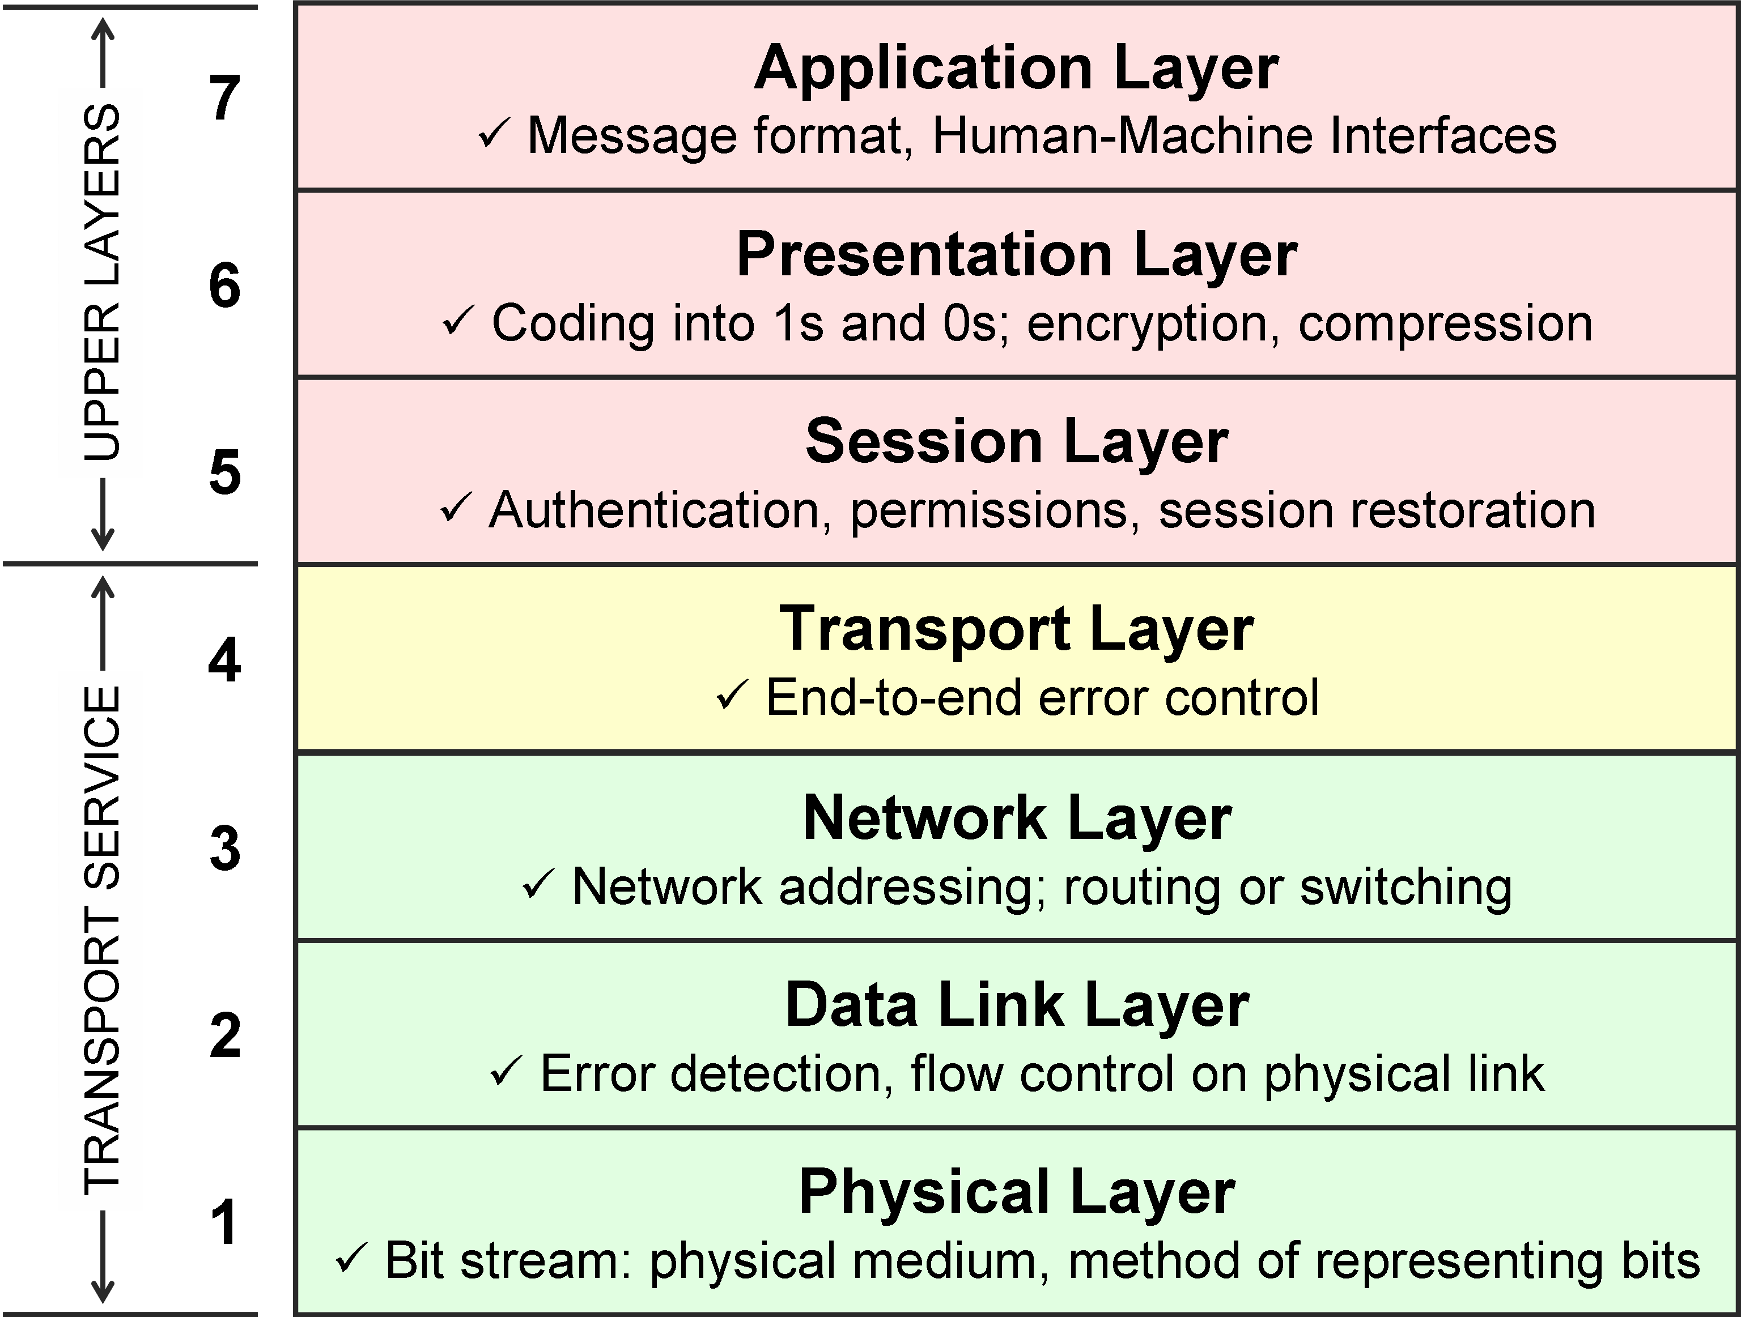
How to communicate
Gizduino IOT and the accompanying Ethernet library implement up to the transport layer in your protocol stack
Implementing the upper layers is the responsibility of the developer

Slide 48
EG: HTTP
Hyper Text Transfer Protocol
Text-based, Connection-oriented (TCP)

Slide 49
Anatomy of an HTTP Request/Response
<initial line, different for request vs. response>
Header1: value1
Header2: value2
Header3: value3
<optional message body goes here, like file contents or query data;
it can be many lines long, or even binary data $&*%@!^$@>
For Requests:
METHOD path HTTP/1.1
For Responses:
HTTP/1.1 Status (Status message)

Slide 50
Some useful Headers
Host:
Content-Type:
Content-Type: application/x-www-form-urlencoded
Content-Type: application/octet-stream
Content-Type: application/json
Content-Length:
Authorization:
Many others

Slide 51
Azure Integration

Slide 52
Brief Azure Overview
Azure has lots of services that can be very useful for IoT projects
Event Hub, IoT Hub, Stream Analytics and lots of other nifty things
For the most part, most services are accessible only with use of some security features (encryption, etc etc)

Slide 53
Limitations of Gizduino IOT
Gizduino is a very simple MCU
Certain limitations will apply to what it can compute
Big Issue: Crypto on Gizduino

Slide 54
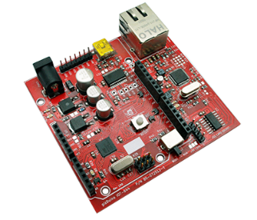
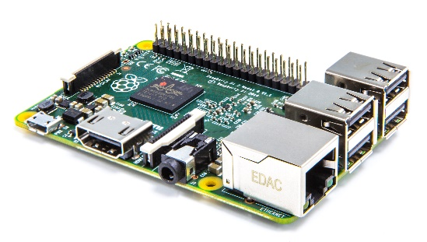

A few ways around it
Hub and Spoke approach
Have a small network between weaker MCUs and a stronger embedded hub that has sufficient CPU like a Raspberry PI2 (or even a PC) to perform encryption and communicate with Azure

Slide 55
Implement your own
Can be more flexible and customizable to particular situations or design decisions
Freedom in the choice of tools and platforms to be used
Less restrictive about the use of encryption, at least during your prototyping stage with cheaper hardware.
BIG NOTE: WHEN IN PRODUCTION, TRY TO IMPLEMENT SOME BEST PRACTICES WITH REGARDS TO SECURITY
Still take advantage of some pre-existing services already available to Azure

Slide 56
Quick Implement-Your-Own
Web apps can serve as really quick implementations of application code that can ingest data produced by IoT
Can be programmed to store data, or to be processed by other services, such as those found in Azure through the use of Azure’s SDK

Slide 57
Quick sample of web code
from flask import Flask, request
import datetime, json
#someobjectstore is defined somewhere
…
@app.route('/Devices/<devid>/state', methods = ['POST'] )
def recordTemp(devid):
temp = request.form['temp']
tdata = { 'DevId':devid,"Time":str(datetime.datetime.utcnow()),"Temperature":temp }
someobjectstore.save('iotsample0917',json.dumps(tdata))
curstate = get_device(devid)
return curstate

Slide 58
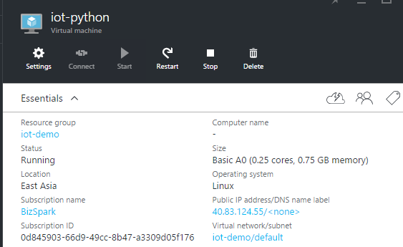
Virtual machines
Virtual Machines are by far the most flexible option in deploying apps that could support any IoT (whether something as simple as the Gizduino IoT or something more powerful)
Come in the platform of your choice, running the software of your choice and the configuration of your choice
They can support almost any scenario, including the limitations of our Gizduino IoT
SDKs still allow integration to many of Azure’s different services

Slide 59
Virtual machines
User manages everything
Scaling, Availability, Patching and Security, Configuration, etc etc

Slide 60
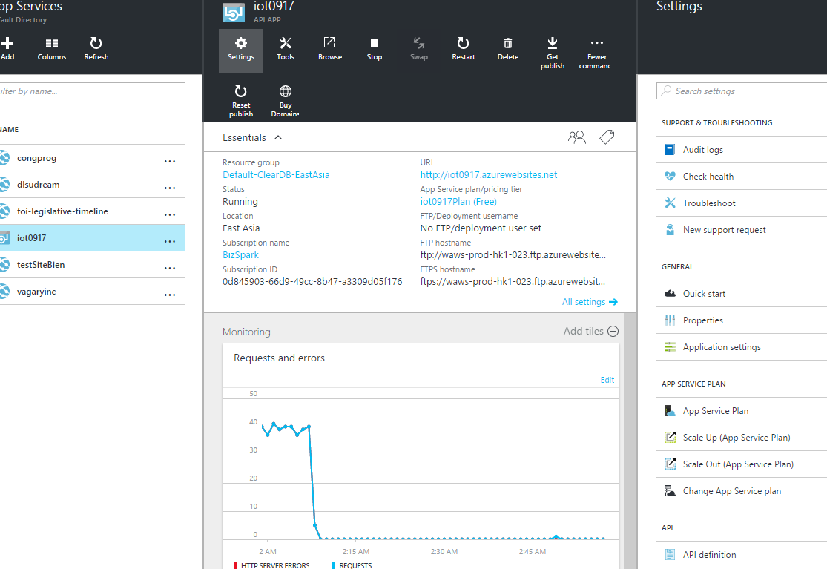
Azure Apps
Allows you to write Web app code without worrying about the underlying infrastructure
Supports a variety of runtimes including ASP.NET, Python, PHP, Node.js and more
Application code can use Azure SDK to integrate into other Azure services.
Limited to supporting HTTP

Slide 61
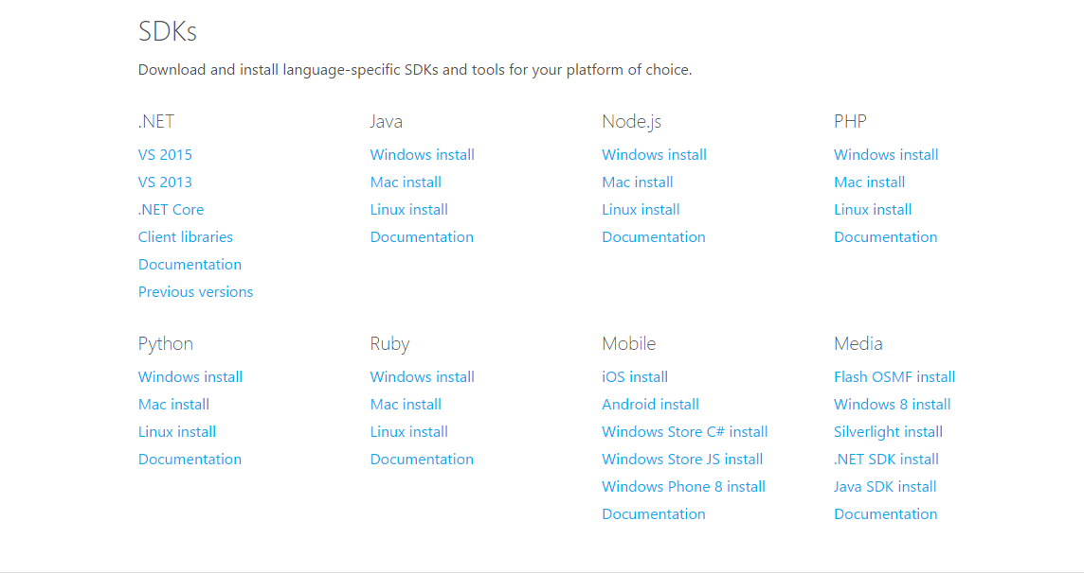
The SDK is your Best Friend

